Slide 1
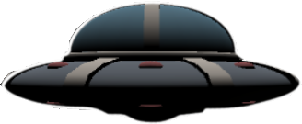
AREA 42
(A prototype)

Slide 2
An overview:
What has changed in the last 6 weeks
Gameplay
Editor tooling examples
What I learned
Post mortem

Slide 3
What has changed
From loose game mechanics to a working prototype
Planet
Player interaction
Menu
AI
UI
Editor tooling

Slide 4
Gamplay & Editor examples

Slide 5
What I learned
Game design wise:
Stop overcomplicating projects -> complex mechanics != more fun
Never expect things to go smooth -> double estimated development time
Spend more time on the concept
Be more realistic about expectations -> “pre-mortem”
Apply more of Patrick’s knowledge -> clearer goals and obstacles
Programming wise:
Good architecture saves time in the end
Geometry shaders
Using unity as an editor (OnValidate, OnReloadScripts, gizmos, referencing, automation)
UI shaders
Math
Unity’s game loop
Tons and tons of small things

Slide 6
Post mortem
The good:
Communication was there, even during times of stress and setback
Clear expectations, artists delivered nice assets
No quarrels, even though it didn’t work out in the end
Still managed to get a working prototype
The bad:
We weren’t able to deliver
Had to work alone for 6,5 weeks
Still no complete game

